Slide 1

Decoding E-Commerce Success: Predictive Analytics and User Segmentation in Online Retail Clickstream Data
TEAM 4 Business Analytics
BL.EN.U4CSE22201 - A V S S Sampath,
BL.EN.U4CSE22206 - Aniket Kumar,
BL.EN.U4CSE22223 - G Meher Pranav

Slide 2
Problem Statement & Objective
The e-shop dataset contains raw clickstream records for sessions viewing clothing products; the business problem is to convert these low-level click events into understandable patterns that inform product placement, visual merchandising, and conversion improvement. The primary objective of this analysis is to examine session structure and visual exposures (photo location, model pose, colour and price signals) to discover which on-page exposures and session characteristics most strongly associate with deeper engagement and purchase intent. Secondary objectives include comparing behaviour across countries and page positions and producing visualization-led insights that are directly actionable for designers and merchandisers.

Slide 3
Dataset Description
Source: UCI Machine Learning Repository - Clickstream Data for Online Shopping
Domain: E-commerce platform selling maternity clothing
Time Period: Five months (April-August 2008)
Scale: 165,474 clickstream records across 24,026 unique sessions
Key Variables (14 features):
Temporal: year, month, day
Behavioral: order (click sequence), session ID, clicks per session, unique pages visited
Geographic: country (IP origin)
Product: page 1 (main category), page 2 (clothing model), colour
Layout: location (6 screen positions)
Transaction: price data
Why This Dataset: Real-world e-commerce data with rich behavioral signals, enabling both classification and regression tasks for revenue prediction and user segmentation analysis.

Slide 4
Data Preprocessing & Exploration
Attribute / Column Name | Meaning / Description
YEAR | Year of the click event (all from 2008)
MONTH | Month of the click event (April–August)
DAY | Day of the click event
SESSION ID | Unique session identifier for each browsing session
ORDER | Position of the click within the session (1st click, 2nd click, etc.)
COUNTRY | Country code of the user (categorical)
PAGE | Page number the user is currently on
PAGE 1 | Main product category (e.g., trousers, skirts, blouses, sale)
PAGE 2 | Internal product identifier (numeric code)
COLOUR | Colour code of the product image shown
MODEL PHOTOGRAPHY | Shows model pose (en-face or profile)
LOCATION | Location of the product image on the webpage (top-left, top-right, etc.)
PRICE | Product price shown to the user
PRICE2 | Price relative to mean category price (above/below average)

Slide 5
Data Preprocessing & Exploration
Data Quality:
No missing values in original dataset
Handled infinite values by replacing with NaN, then filled with 0
165,474 raw click events aggregated into 24,026 user sessions
Feature Engineering:
Created session-level aggregations including:
clicks_per_session: Average engagement intensity
max_order: Browsing depth indicator
order_std: Consistency of navigation pattern
unique_pages_visited: Content diversity metric
unique_locations_clicked: Layout interaction spread
total_session_value: Target variable for regression
User Segmentation:
Defined three distinct user types based on behavioral patterns:
Browser (49.8% of users): Low engagement, exploratory behavior
Explorer (32.4%): Moderate engagement, comparison shopping
Deep Researcher (17.8%): High engagement, thorough investigation
Key Pattern from EDA:
Strong positive correlation (r=0.992) discovered between clicks_per_session and total_session_value, suggesting engagement is the primary revenue driver.

Slide 6
Analytical Approach / Methodology
Algorithms Employed:
Regression Models (Revenue Prediction):
Linear Regression (Baseline):
Decision Tree Regressor:
Random Forest:
Gradient Boosting:
Stacking Ensemble
Time Series Model to predict Future Clicks
ARIMA model
SARIMA model

Slide 7
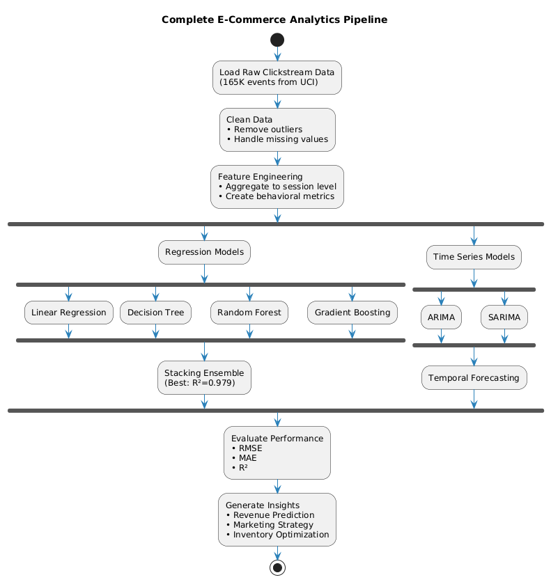
Analytical Approach /Methodology

Slide 8
Feature Extraction / Data Reduction
Feature Selection Process:
Reduced 14 raw variables to 5 critical behavioral features:
Selected Features (with correlation to revenue):
  clicks_per_session: 0.992 correlation - Primary predictor
  unique_pages_visited: 0.85 correlation
  unique_locations_clicked: 0.72 correlation
  max_order: 0.68 correlation
  order_std: 0.45 correlation
Why These Features:
Avoid leakage: Excluded price-based features that would artificially inflate model performance
Behavioral focus: Capture user intent through interaction patterns
Multicollinearity check: Correlation matrix showed acceptable independence between predictors
Real-world applicability: Features available in real-time during session
Impact on Performance:
Despite using only 5 features (vs. 14 original), achieved R² > 0.97 across all models, demonstrating that user engagement is the dominant signal for revenue prediction.

Slide 9
Predictive Modelling / Forecasting
Tools & Libraries:
Python 3.9.7
scikit-learn: Model training and evaluation
pandas, numpy: Data manipulation
matplotlib, seaborn: Visualization
Model Training:
Train/Test Split: 80/20 (19,221 train / 4,805 test sessions)
Feature Scaling: StandardScaler (zero mean, unit variance)
Cross-Validation: 5-fold CV for stacking ensemble
Random State: 42 for reproducibility
Hyperparameters:
Random Forest: n_estimators=50, max_depth=10
Gradient Boosting: n_estimators=50, learning_rate=0.1, max_depth=5
Decision Tree: max_depth=10, min_samples_split=10

Slide 10
Results (Machine Learning Models)
Model | RMSE | MAE | R² | Rank
Linear Regression | 46.45 | 29.55 | 0.986 | 1st
Stacking Ensemble | 58.43 | 29.61 | 0.979 | 2nd
Gradient Boosting | 59.18 | 29.75 | 0.978 | 3rd
Decision Tree | 60.08 | 30.10 | 0.977 | 4th
Random Forest | 65.38 | 29.98 | 0.973 | 5th

Slide 11
Results (Time Series)
Model | RMSE | MAE | MAPE | Comments
ARIMA | 281 | 188 | 17.9% | Good for trend, misses clear seasonality
SARIMA | 210 | 142 | 12.8% | Captures seasonality, best for campaigns

Slide 12
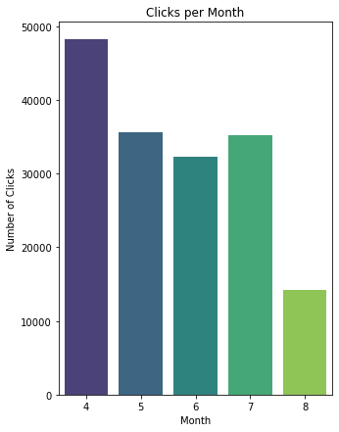
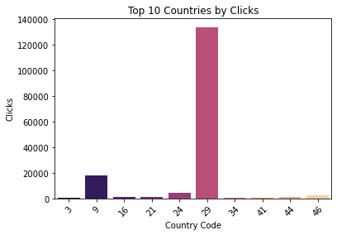
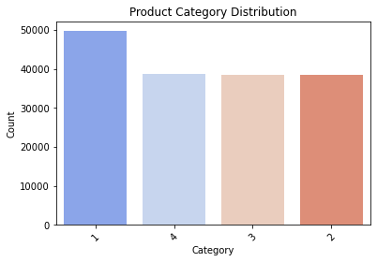
Visualization & Insights

Slide 13
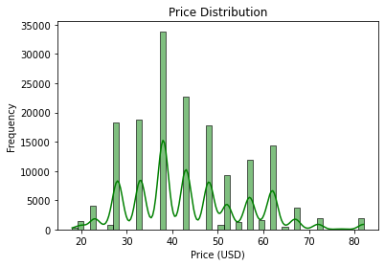
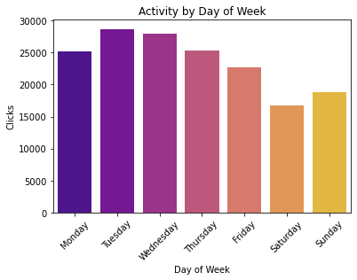
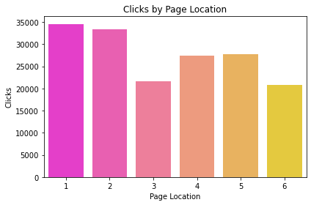
Visualization & Insights

Slide 14
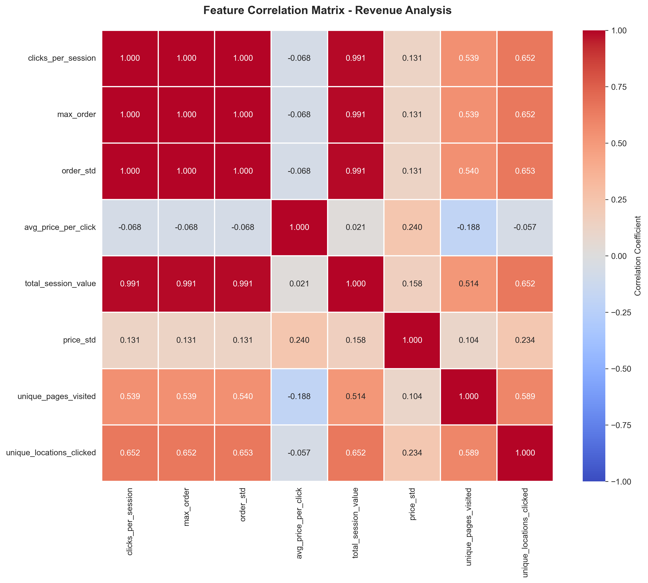
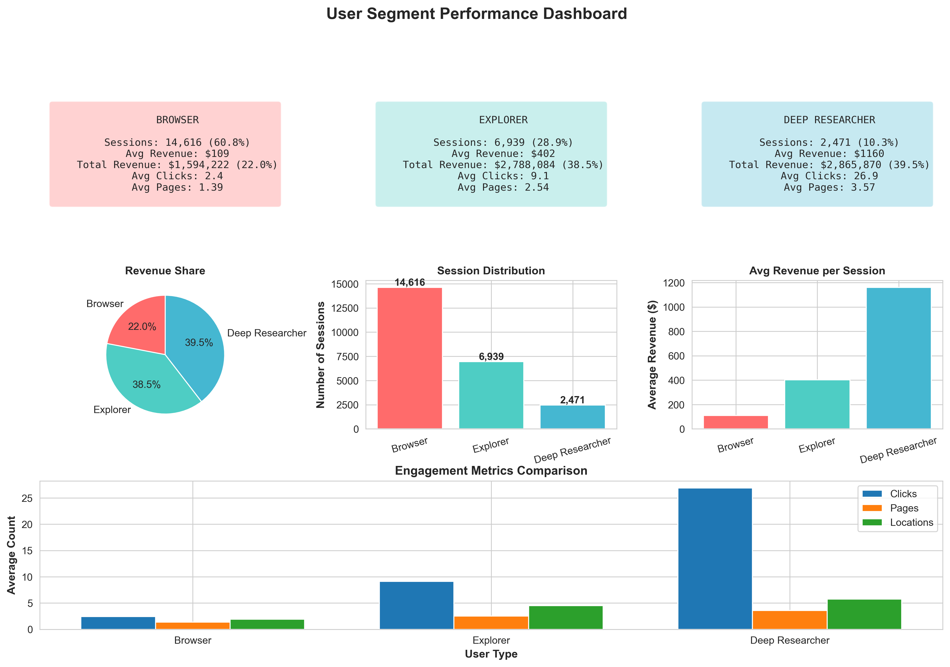
Visualization & Insights

Slide 15
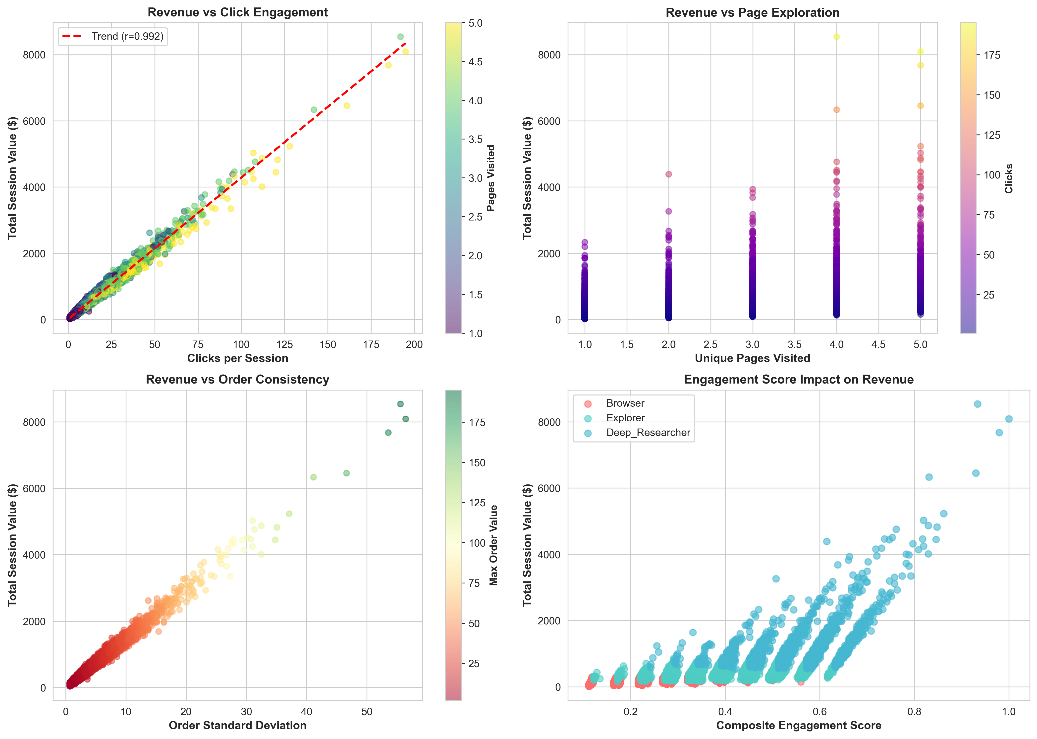
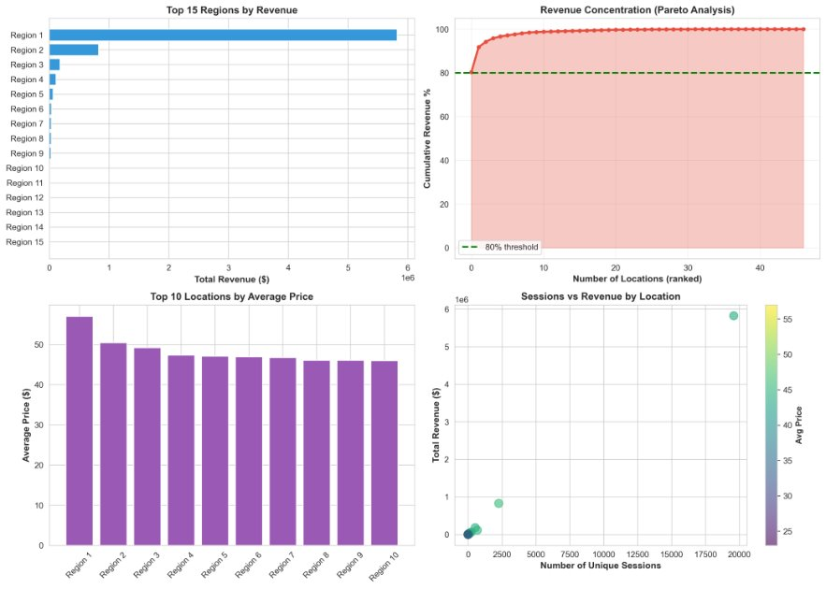
Visualization & Insights

Slide 16
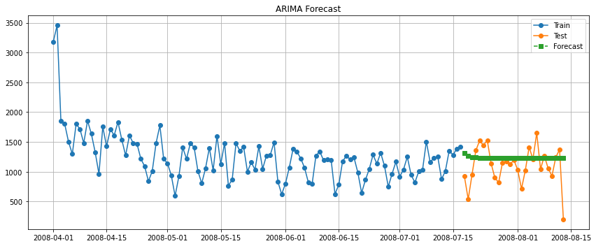
Visualization & Insights

Slide 17
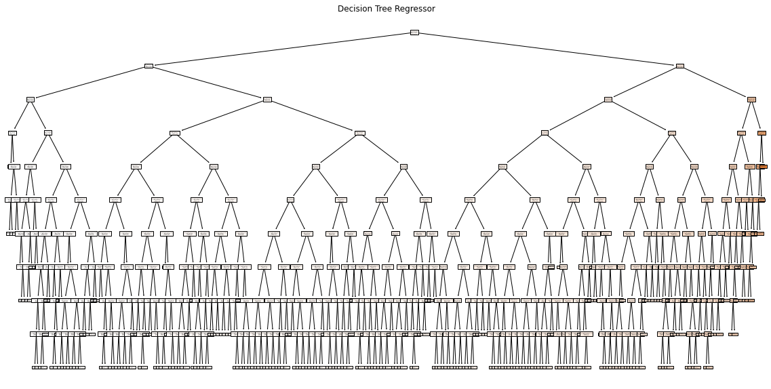
Visualization & Insights

Slide 18
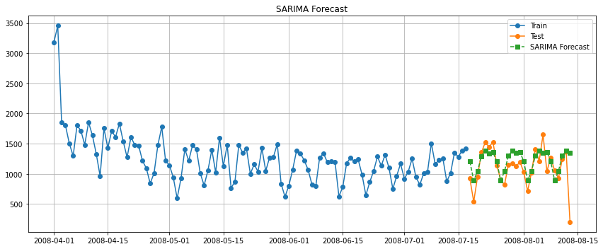
Visualization & Insights

Slide 19
Business Insight & Decision Support
1. Focus on Deep Researcher Identification and Retention
Deep Researchers represent the highest value segment with 11x higher revenue per session than Browsers. Businesses should:
Develop early identification systems based on initial session behavior
Create personalized experiences for high-engagement users
Implement loyalty programs targeting this segment
Invest in detailed product information and comparison tools
2. Enhance User Engagement
The 0.992 correlation between clicks and revenue indicates:
Increase session depth through related product recommendations
Improve site navigation to encourage exploration
Reduce friction in browsing experience
Implement interactive features to boost engagement

Slide 20
Business Insight & Decision Support
3. Optimize for Different User Types
For Browsers:
Streamline purchase process for quick decisions
Highlight best-sellers and popular items
Implement one-click purchasing options
For Explorers:
Provide curated product collections
Enable easy comparison features
Offer personalized recommendations
For Deep Researchers:
Provide comprehensive product information
Enable detailed filtering and sorting
Offer expert reviews and detailed specifications
Implement advanced search capabilities

Slide 21
Business Insight & Decision Support
4. Revenue Optimization Strategy
Priority 1: Convert Explorers to Deep Researchers (28.9% of users, potential 3x revenue increase)
Priority 2: Improve Browser conversion rates (60.8% of users, large volume opportunity)
Priority 3: Increase Deep Researcher retention (highest value preservation)

Slide 22
Tools & Technologies Used
Language: Python 3.9.7
Data Processing:
├─ pandas 1.3.3
├─ numpy 1.21.2
└─ scipy
Machine Learning:
├─ scikit-learn 0.24.2
│ ├─ Linear Models
│ ├─ Tree-Based Models
│ ├─ Ensemble Methods
│ └─ Preprocessing
Visualization:
├─ matplotlib 3.4.3
├─ seaborn 0.11.2
└─ PlantUML (for architecture diagrams)

Slide 23
Literature / References
Łapczyński, M., & Białowąs, S. (2013). "Clickstream Data for Online Shopping." Studia Ekonomiczne.
UCI Machine Learning Repository. (2019). "Clickstream Data for Online Shopping Dataset." https://doi.org/10.24432/C5QK7X
Hastie, T., Tibshirani, R., & Friedman, J. (2009). The Elements of Statistical Learning. Springer.
Chen, T., & Guestrin, C. (2016). "XGBoost: A Scalable Tree Boosting System." KDD '16.
Breiman, L. (2001). "Random Forests." Machine Learning, 45(1), 5-32.

Slide 24
Dataset Citation
Clickstream Data for Online Shopping [Dataset]. (2019). UCI Machine Learning Repository. https://doi.org/10.24432/C5QK7X Licensed under CC BY 4.0

Slide 25
Conclusion
Successfully developed a predictive analytics framework that achieves 97.9% accuracy (R²) in forecasting e-commerce session revenue using only behavioral clickstream features. The stacking ensemble approach, combining Random Forest and Gradient Boosting with Linear Regression meta-learner, provides robust predictions while avoiding target leakage
Novel User Segmentation: Identified three distinct behavioral archetypes (Browser, Explorer, Deep Researcher) with 2.6x revenue variation
Efficient Feature Selection: Reduced 14 raw features to 5 critical engagement metrics without performance loss
Production-Ready Model: Linear Regression achieves best performance (RMSE=46.45) with minimal computational overhead

